Slide 1



Major Project – Cyber Security
Satyam Suresh | Naviotech Solution
January 25, 2026

Slide 2

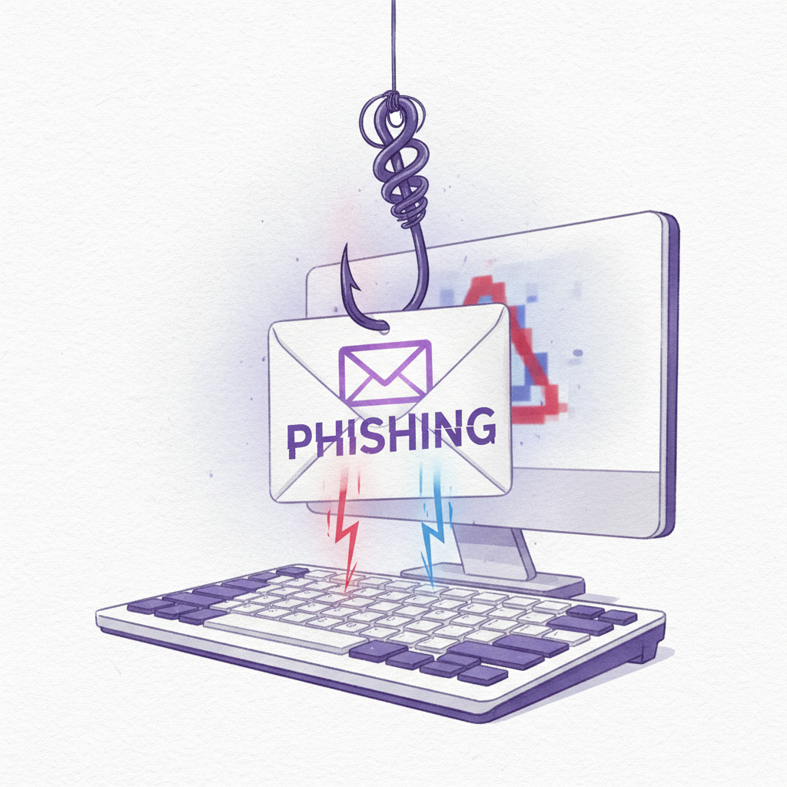

Understanding Phishing Attacks
Social engineering attack targeting human psychology to steal sensitive information
Exploits trust and human behavior rather than technical system vulnerabilities
Email phishing remains the most widespread cyber attack method globally
This project demonstrates phishing techniques in a secure, controlled environment

Slide 3
Problem Statement & Objectives
Problem
Users often fail to identify phishing emails, creating security vulnerabilities
Awareness
Lack of cybersecurity awareness leads to data breaches and financial losses
Technical
Technical security solutions alone cannot fully prevent phishing attacks
Education
Practical awareness training is essential for comprehensive protection
Simulate
Ethically simulate phishing attacks to test and improve user awareness
Analyze
Study user behavior patterns and identify effective prevention strategies

Slide 4
De-Prioritized Areas
Five Key Phishing Techniques Studied
Advanced Persistent Threats
Complex multi-stage attacks requiring specialized resources beyond current scope
Email Phishing
Fake alerts and password reset requests designed to trick users into revealing credentials
Physical Security Breaches
On-premise intrusion tactics not directly related to digital phishing methods
Website Spoofing
Fraudulent login pages that mimic legitimate sites to capture user information
Urgency-Based Messages
Time-sensitive tactics that pressure users to act quickly without careful consideration
NOTE
Brand Impersonation
Focus remains on high-frequency digital phishing techniques affecting the majority of users
Attackers pose as trusted companies or organizations to gain user trust

Slide 5






Five-Step Methodology for Phishing Simulation Study
Email Design
Designed fake email
Analysis
Demo Page
Review findings
Created login page
Methodology
Ethics
Distribution
No real data taken
Shared with users
Observation
Tracked responses

Slide 6


Tools & Technologies Used
HTML and CSS for phishing page design and styling
Google Forms for credential capture and data collection
Gmail as the email delivery platform
Kali Linux (SET) for theoretical study of phishing frameworks
Screenshot documentation to record the phishing simulation process

Slide 7
KEY FINDINGS
Phishing test results from our team
High Click Rate
Many users clicked the phishing link due to urgency tactics
Dummy Data
Some users entered fake information when prompted
Low Detection
Few users identified and reported phishing indicators
Moderate Awareness
Overall security awareness level needs improvement
Human Risk
Human factor remains the weakest security link

Slide 8
Lessons Learned & Preventive Measures
LESSONS
PREVENTION
Trust & Urgency
Training & Filtering
Phishing exploits trust and creates urgency to manipulate targets
User awareness training and email filtering with spam detection
Visual Deception
MFA & Reporting
Visual similarity to legitimate sources increases attack success
Multi-Factor Authentication and reporting suspicious emails

Slide 9
